Slide 1
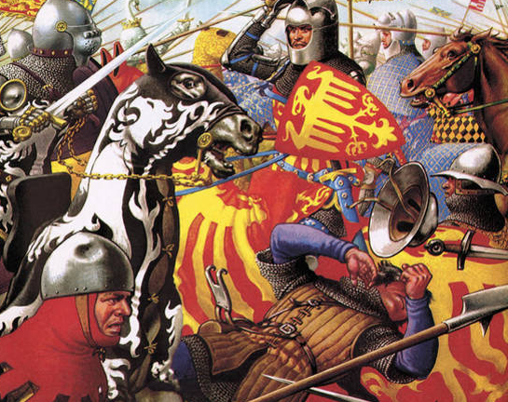
Chapter 2.5.2 the Late Middle Ages
The Great Schism, Hundred Years War, and the Reconquista

Slide 2
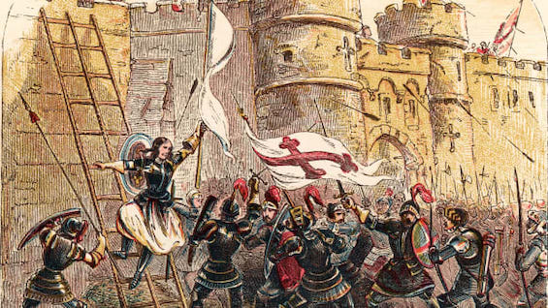
The Late Middle Ages
The Middle Ages is divided into three periods
  Early Middle Ages 500 -1000 – Rise of the Franks, Vikings, Feudalism begins
  High Middle Ages 1000 -1300 – William the Conquer, Magna Carta, Great Schism, Crusades
  Late Middle Ages 1300 -1500 – Black Death, Hundred Years War, Reconquista and another Schism
Late Middle Ages 1300 – 1500
  Black Death was a pandemic that killed between 20-40 millions people in Europe
  Hundred Years War was a war between France and England.
  Reconquista was the removal of Muslim kingdoms from Iberia (Spain)
  2nd Great Schism was a disagreement over which pope had authority over the church

Slide 3

What was the Great Schism
The Great Schism refers to a split in the Church
This happened a few times during the Middle Ages
  1054 was the 1st
  1417 was the 2nd

Slide 4
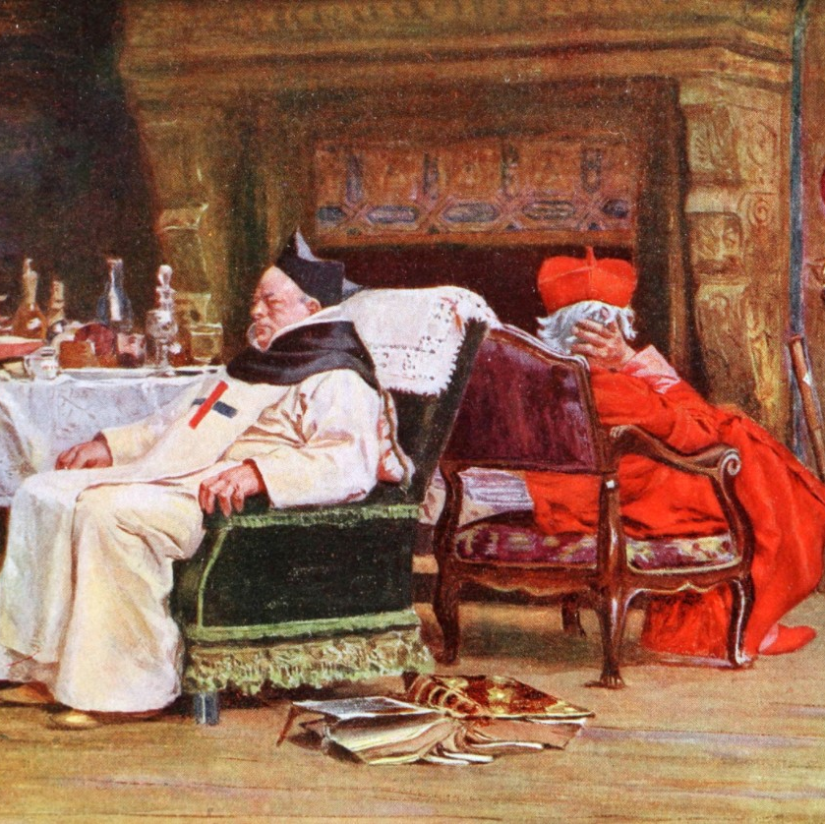
1st Schism
1054 was the 1st Great Schism
  After years of power struggles about doctrine and practices, the Church split
    Byzantines had refused to help the Pope out several times…he had to ask the Franks instead – Holy Roman Empire – angered the Byzantine ruler
    The use of icons was disagreed upon
  The Byzantine emperor refused to recognize the Pope as the leader of the Church
  Both the Pope and the Emperor excommunicated each other
  This created two different Christian Churches
    Western Europe followed the Pope and became known as the Catholic Church
    Eastern Europe followed the Emperor and his Archbishop…became known as the Eastern Orthodox Church

Slide 5
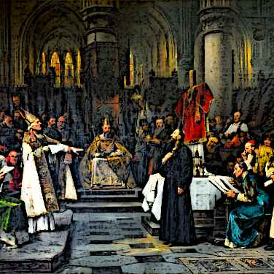
2nd Great Schism
The second Great Schism occurred in between 1378 and 1417
It is referred to as the Great Western Schism – in reference to Western Europe and the Catholic Church
It did not involve the Byzantine Empire or the Eastern Orthodox Church.
The main issue was several church officials claimed to be the pope with different kingdoms recognizing different popes as leader of the Catholic Church
This was resolved in 1417 when a council of bishops met in Germany and voted on a new pope that all Catholics recognized

Slide 6
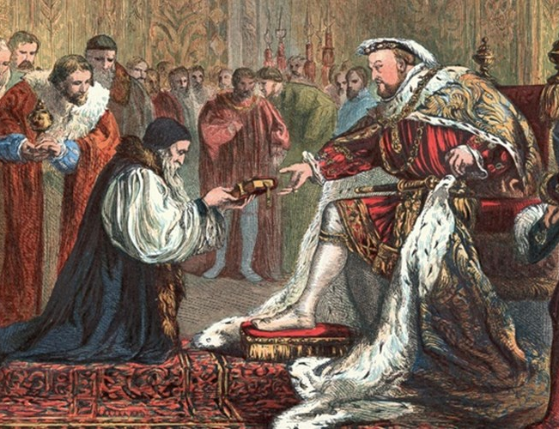
Growing problems in the Church
Beside power struggles within the Church, powerful kings were challenging the Church’s authority
Many people also were concerned with the growing wealth and power of the Church
Many people began to criticize the church for the corruption within it.

Slide 7
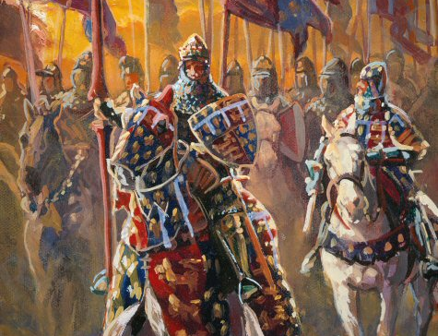
What was the Hundred Years War about?
This was a war between England and France that started in 1337 and ended around 1453.
The main reason for the war was because there was disagreement over who was in charge of France.
The English claimed they had a right to the thrones, and the war really started when Edward III of England invaded France, claiming he was the king of France…that didn’t set well with the French

Slide 8
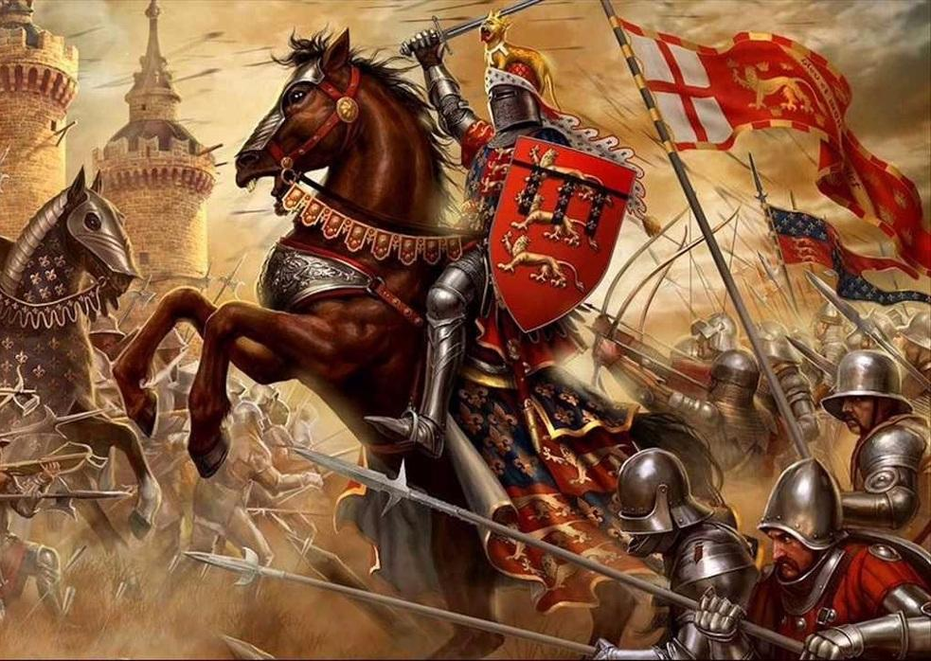
England has the upper hand early
For the first part of the war, England was in control.
Under Edward III and his son, the Black Prince, England won many battles and occupied territory in France.
To make matter worse, Charles VI, the king of France, went insane, and was removed from his rule…this led to the French spiraling into their own civil war during the actual war with the English
Henry V of England came to the throne and extended rule further into French lands and was even briefly recognized as king of both England and France…this was short lived though. He died soon after this recognition

Slide 9
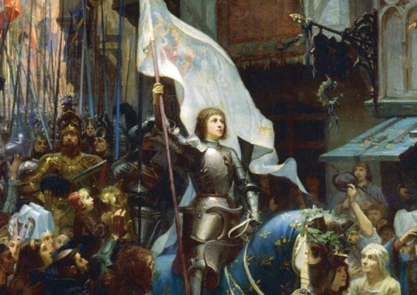
Who was Joan of Arc?
Joan of Arc, was a young peasant girl from France.
  She claimed she heard voices telling her to join the fight and save France from the English
  She was 16 when she joined the fight
    No experience in combat or politics
    Could not read or write
She turned the tide of the war when she was able to lift the siege of Orleans.
  The English had surrounded the city
  It was one of the most important cities the French still controlled at this point
After saving the city from the English, she escorted young Charles VII to Reim, where he was crowned king of France.

Slide 10
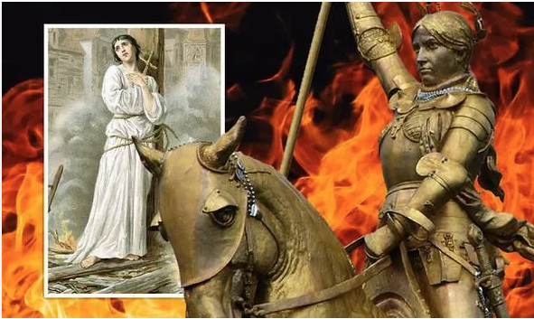
What happened to her?
After succeeding in leading the French to victory at Orleans and escorting young Charles VII so he could be crowned king she was captured.
She was accused of being a witch
  They claimed the devil was communicating with her
  The also claimed she wore men’s clothes
Initially she was sentenced to jail, but later she was executed.
  She was burned at the stake
Years later, the church recognized this as a grave injustice
Today, she is recognized as a saint in the Catholic Church
She is a national hero in France and a symbol of freedom

Slide 11

How did the Hundred Years War end?
After over a hundred years of fighting, the French were able to regain most of the land lost during the war and became a unified nation.
England would rule as an Island nation
England was also become entangled in their own civil war…It was known as the War of the Roses.
It ended with Henry Tudor being crowned king of England

Slide 12
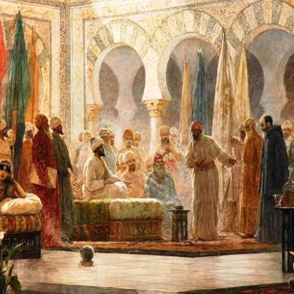
What was the Reconquista?
The Reconquista refers to the recapturing on lands in Iberia – Spain and Portugal
In the 600 and 700s the Muslims had expanded and gained control of Iberia
Christian kingdoms there wanted to drive the Muslims out and unite Iberia as a Christian region.
The Reconquista begins in the 700s and ends around the late 1400s

Slide 13
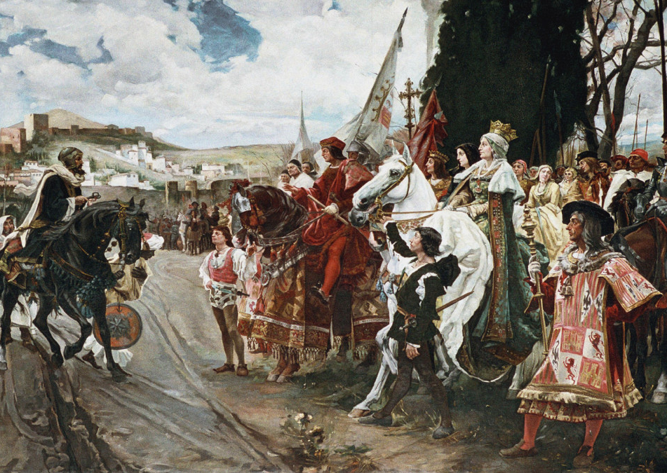
Driving the Muslims out of Iberia
Christians were successful in claiming large amounts of land by 1250
There were three powerful Christian kingdoms in Iberia
  Castile
  Aragon
  Portugal
The only kingdom under Muslim control was Granada, in the southern region.

Slide 14
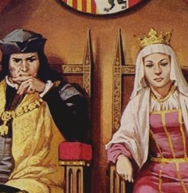
Spain is formed
In 1469, King Ferdinand and Queen Isabella married and united their kingdoms, Aragon and Castile.
This new kingdom was called Spain
They wanted their kingdom to be Catholic
They forced many Jews, Muslims, and non-Catholics to leave the region
King Ferdinand and Queen Isabella set up the Spanish Inquisition to convert the entire region in a Catholic Christian kingdom

Slide 15
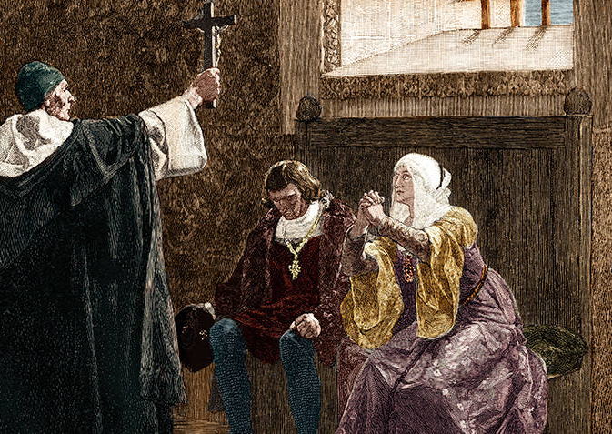
What was the Spanish Inquisition?
The Spanish Inquisition was a religious court system designed to search and find any people who committed crimes against the Catholic Church, they also were looking to remove and non- Catholics from Spain
If convicted of crimes, they were punished
Many people were forced to admit to crimes when they were tortured until they confessed.
The Spanish Inquisition drove many people out of Spain and killed thousands upon thousands of people.

